Slide 1

TEMPORAL LOGIC
Notes:
1

Slide 2
TEMPORAL LOGIC
In classical logic, formulae are evaluated within a single fixed world.
For example, a proposition such as “it is Monday” is either true or false.
Propositions are then combined using constructs such as ‘∧’, ‘¬’, etc.
In temporal logic, evaluation takes place within a set of worlds. Thus, “it is Monday” may be satisfied in some worlds, but not in others.
The static notion of truth is replaced by a dynamic one
the formulas may change their truth values as the system evolves from state to state
The accessibility relation between worlds then describes a particular model of time.
The set of classical operators is extended with various temporal operators which navigate by this relation

Slide 3
TEMPORAL LOGIC
Commonly, propositional, discrete, linear temporal logic extends the descriptive power of propositional logic in order to be able to
describe sequences (hence:linear)
of distinct (hence:discrete) worlds,
with each world being similar to a classical(propositional) model
So, we can equivalently describe the basis of our model of time in terms of a sequence of worlds, a sequence of states, or a sequence of propositional models.
Each state in the sequence is taken as modeling a different moment in time; hence the name temporal logic

Slide 4
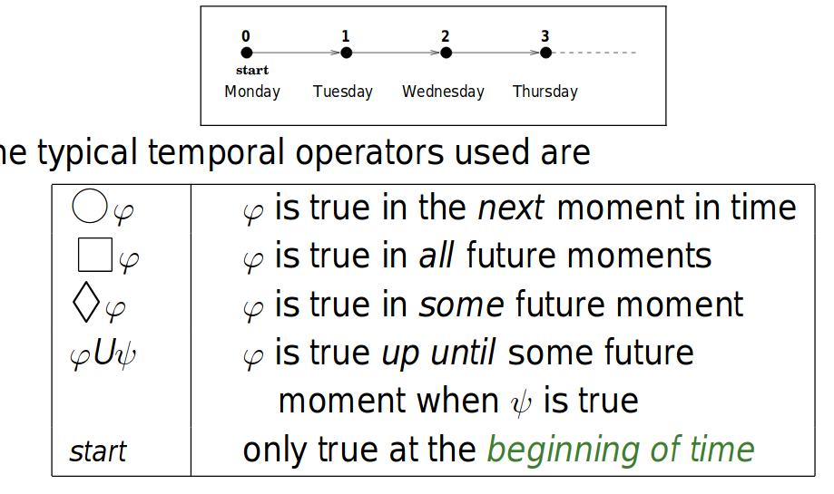
PTL IN A NUTSHELL
We use a simple temporal logic (PTL) where the accessibility relation characterizes a discrete, linear order isomorphic to the Natural Numbers,N
Typical Operators used

Slide 5
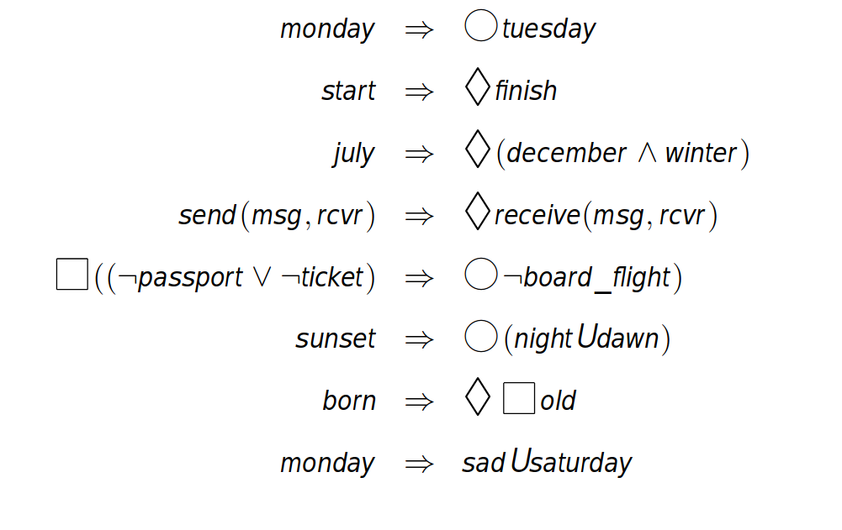
PTL EXAMPLES

Slide 6
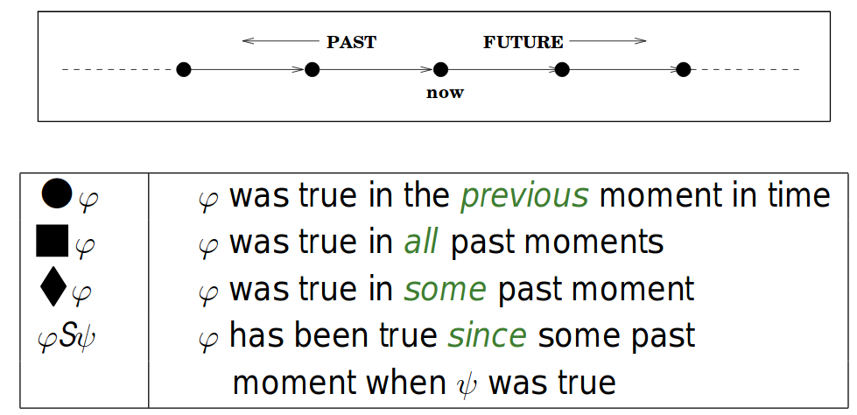
LOOKING BACK

Slide 7
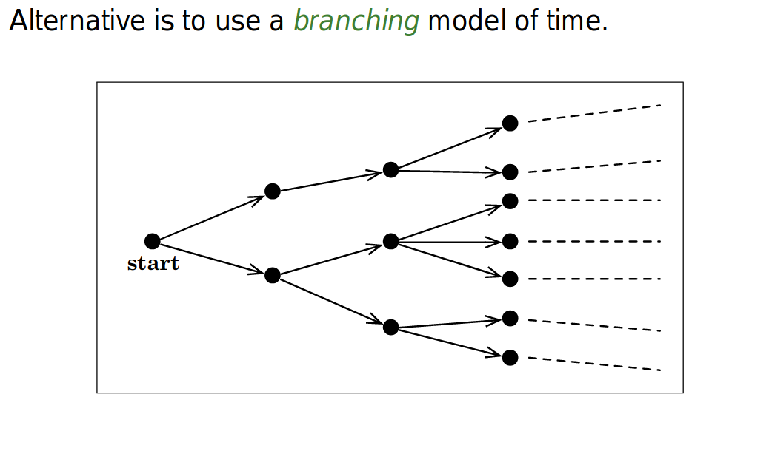
BRANCHING MODELS

Slide 8
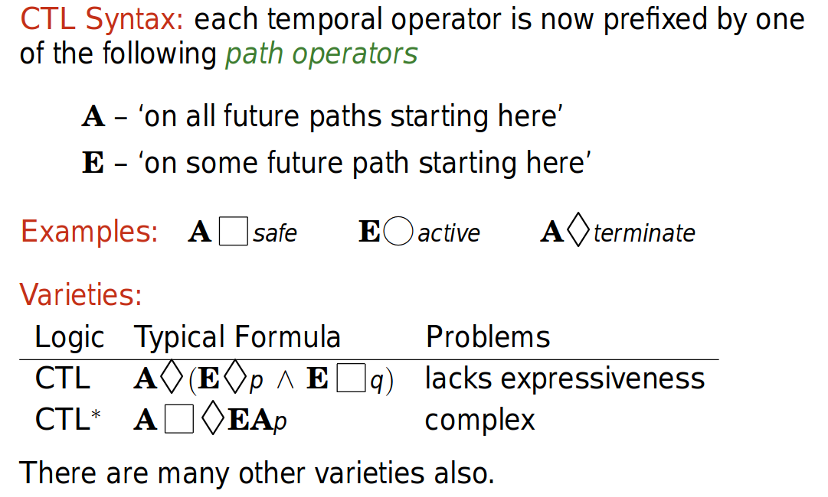
BRANCHING TEMPORAL LOGIC (COMPUTATIONAL TREE LOGIC)
Notes:
8

Slide 9
TEMPORAL LOGIC GETS EVERYWHERE
specification and verification of (dynamic) programs
specification and verification of distributed and concurrent programs
representation of tense in natural language
characterizing temporal database queries
verification of finite state models derived from ‘real’ systems (model checking)
agent theory
direct execution
real-time analysis
temporal data mining
exploring the limits of decidability

Slide 10
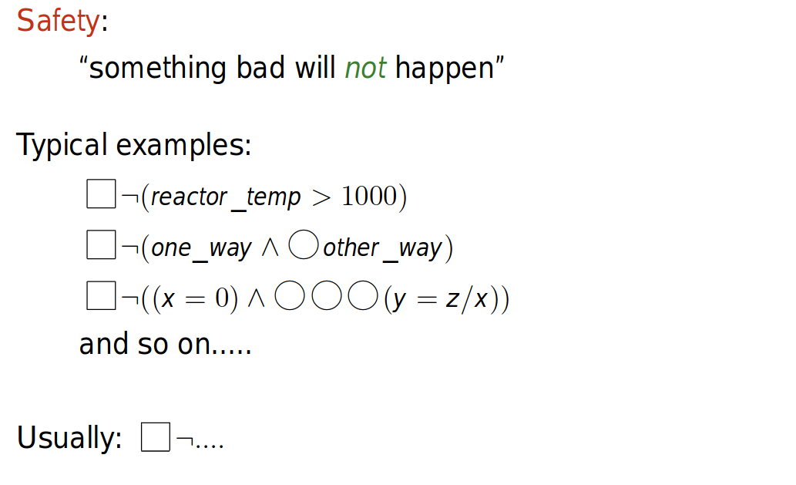
INTUITION: SAFETY PROPERTY

Slide 11
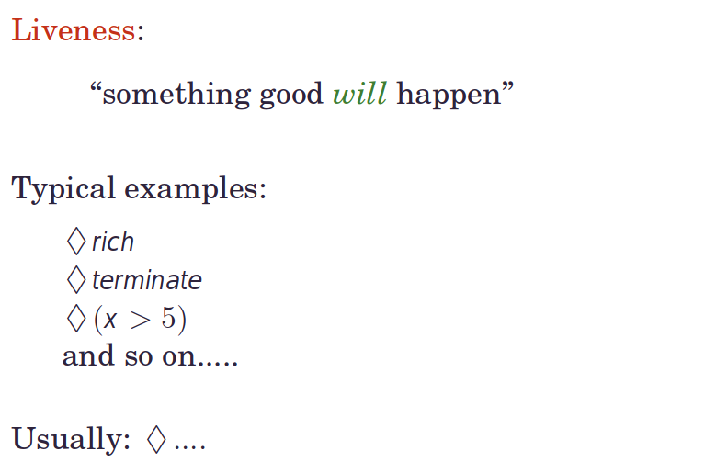
INTUITION: LIVENESS PROPERTY

Slide 12
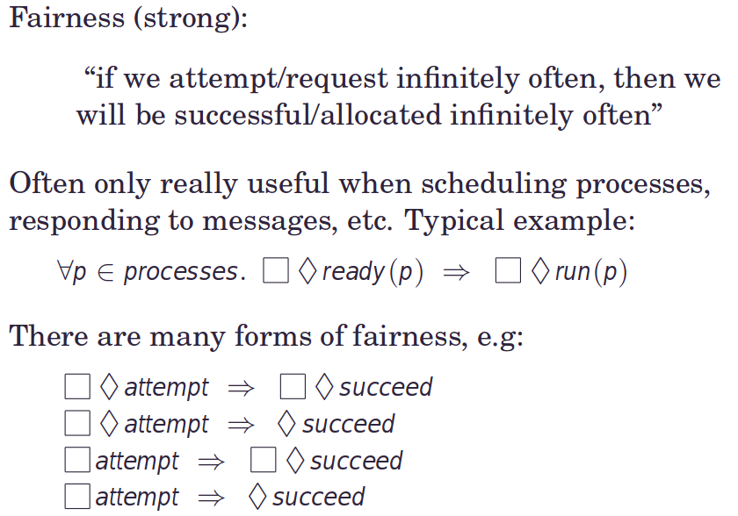
INTUITION: FAIRNESS PROPERTY

Slide 13
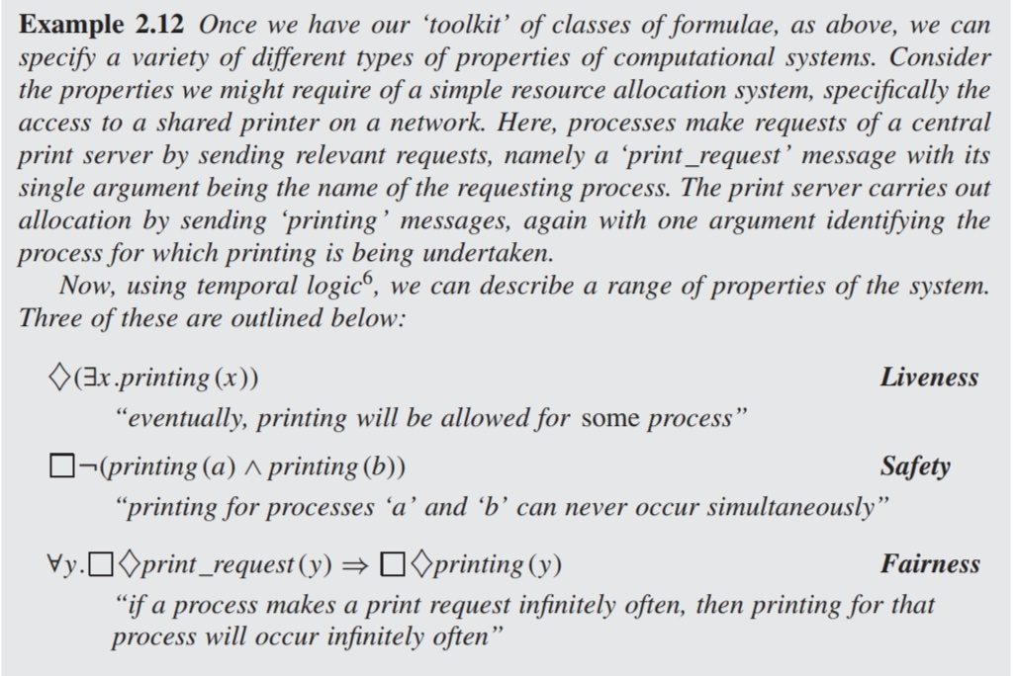
EXAMPLE
Notes:
13

Slide 14
USING TEMPORAL FORMULAE
We can usefully specify, using temporal formulae, systems with
dynamic,
concurrent,
distributed,
.....etc.....
aspects.

Slide 15
USING TEMPORAL FORMULAE
For example, from the resource allocator specification earlier, we might:
Given a program intended to implement a resource allocator, we might prove that the program’s specification implies some temporal requirements
Given a program that implements such a resource allocation system, we might model check a finite representation of the program to see if the implementation actually satisfies the required specification;
We might be able to synthesize a program directly from the above temporal logic requirement; or
We might be able to directly execute the above temporal specification to provide an implementation.

Slide 16
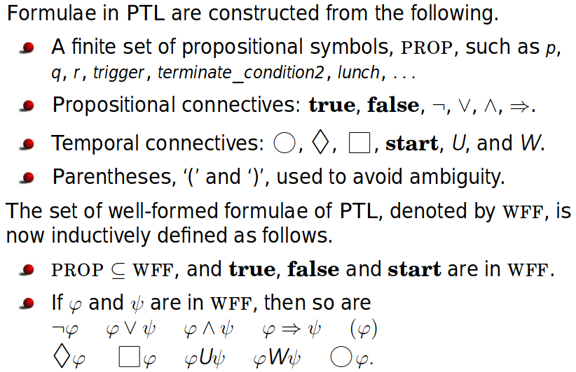
PTL SYNTAX
Formulae in PTL are constructed from the following:

Slide 17
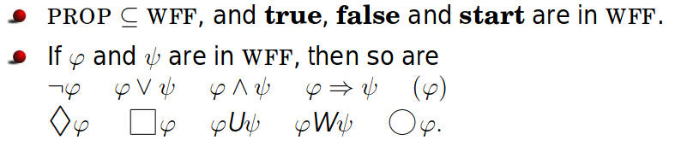
PTL SYNTAX
The set of well-formed formulae of PTL, denoted by WFF, is now inductively defined as follows.

Slide 18
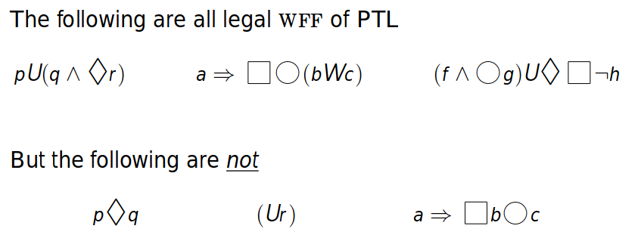
EXAMPLES
Notes:
18

Slide 19
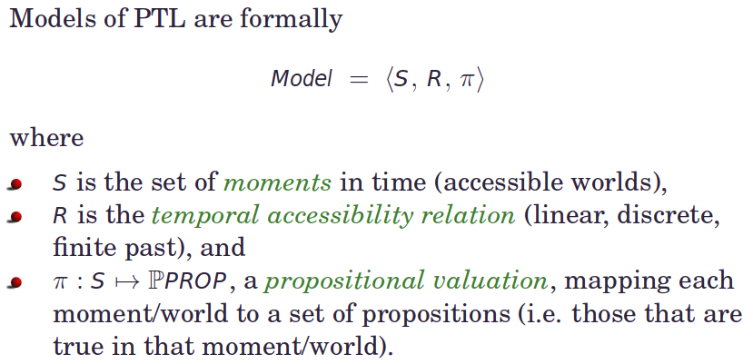
SEMANTIC STRUCTURES
Notes:
19

Slide 20
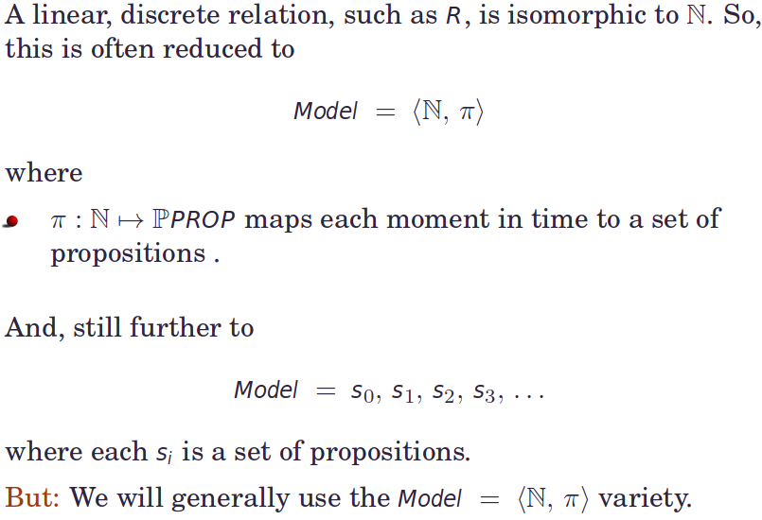
SEMANTIC STRUCTURES
Notes:
20

Slide 21
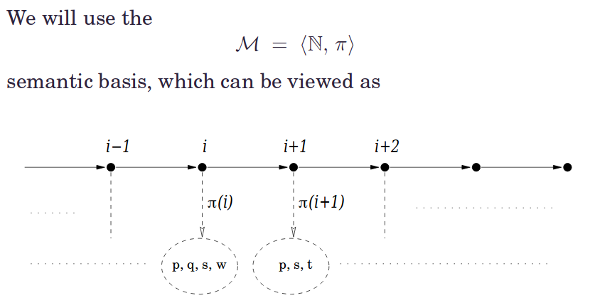
SEMANTIC STRUCTURES
Notes:
21

Slide 22
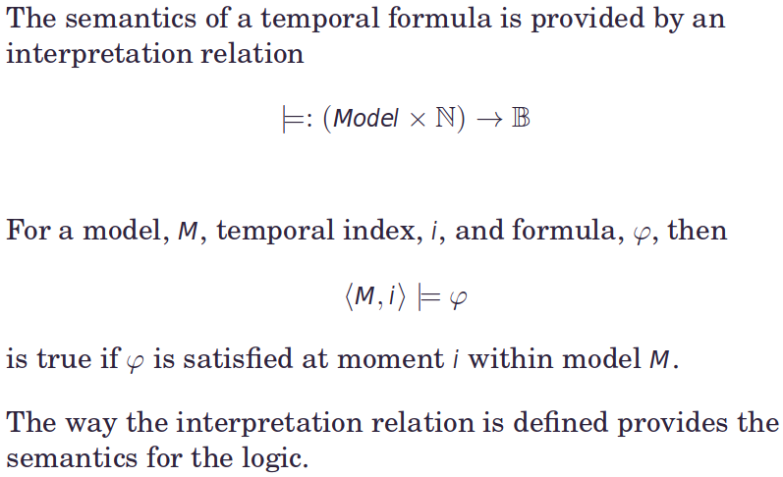
FORMAL SEMANTICS
Notes:
22

Slide 23
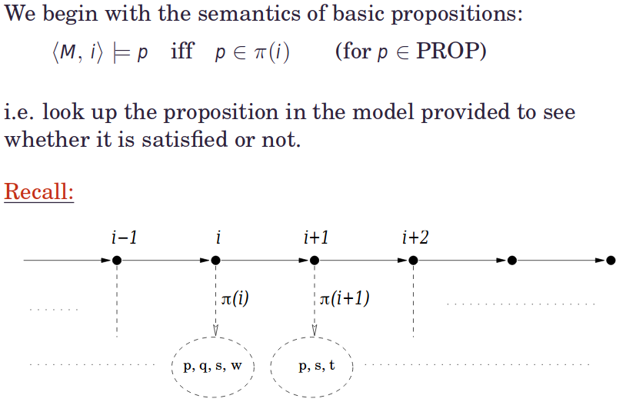
SEMANTICS OF PROPOSITIONS
Notes:
23

Slide 24
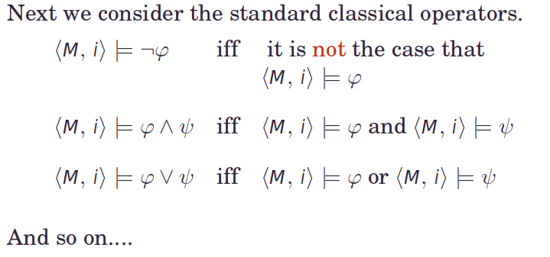
SEMANTICS OF CLASSICAL OPERATORS
Notes:
24

Slide 25
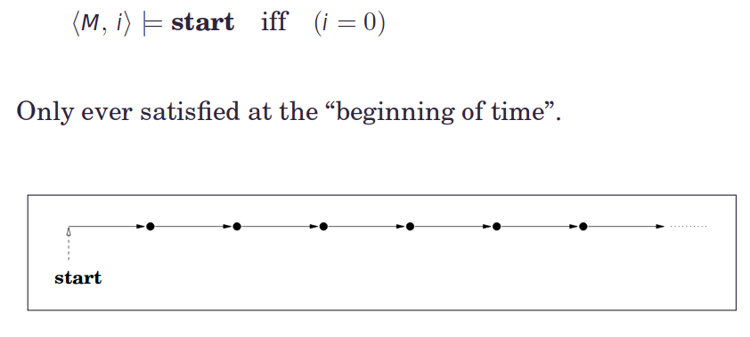
TEMPORAL OPERATORS: START
Notes:
25

Slide 26
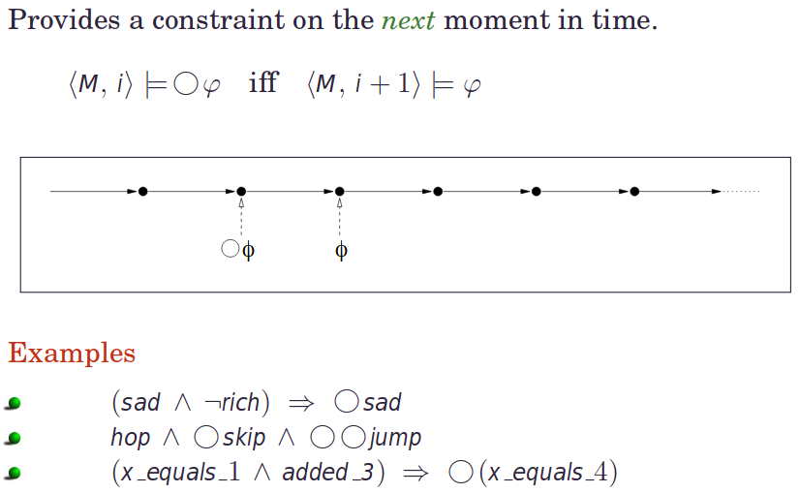
TEMPORAL OPERATOR: NEXT
Notes:
26

Slide 27
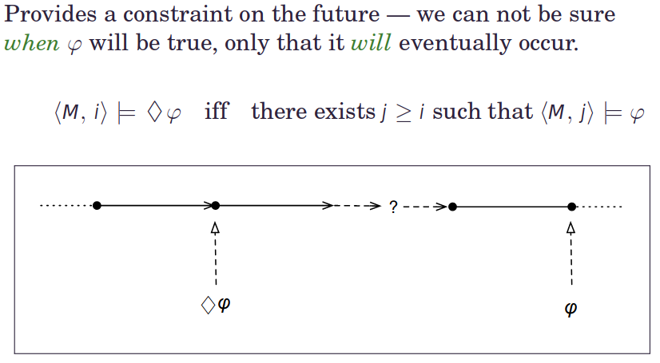
TEMPORAL OPERATOR: SOMETIME
Notes:
27

Slide 28
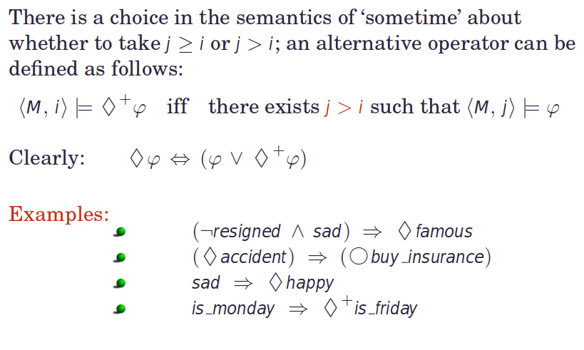
TEMPORAL OPERATOR: SOMETIME+
Notes:
28

Slide 29
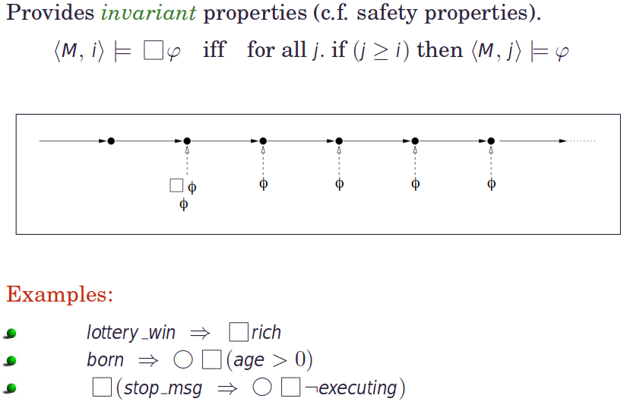
TEMPORAL OPERATOR: ALWAYS
Notes:
29

Slide 30
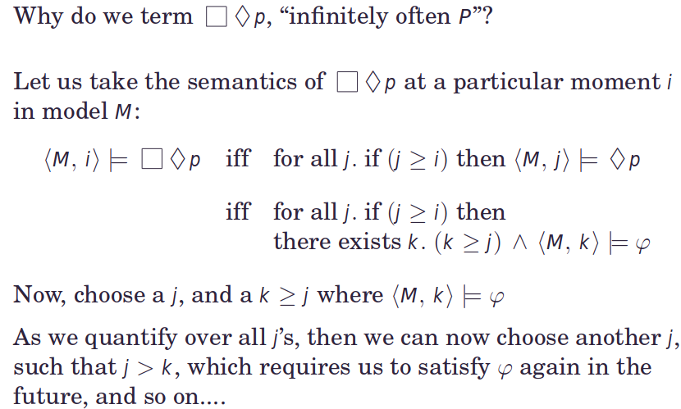
EXAMPLE
Notes:
30

Slide 31
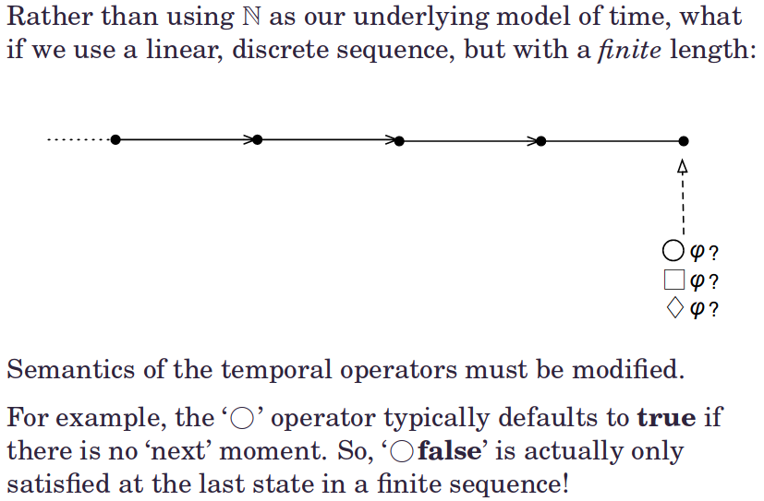
ASIDE: NO FUTURE
Notes:
31

Slide 32
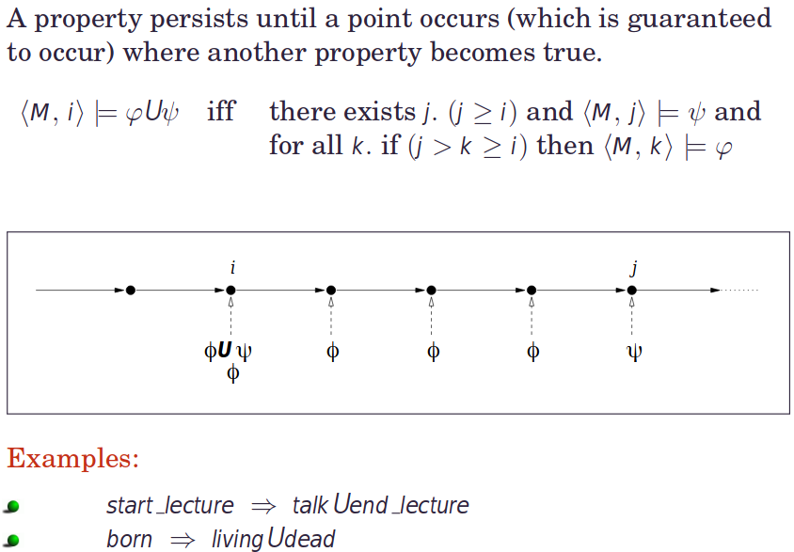
TEMPORAL OPERATOR: UNTIL
Notes:
32

Slide 33
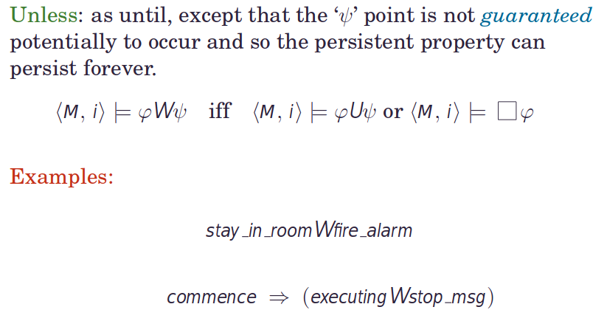
TEMPORAL OPERATOR: UNLESS
Notes:
33

Slide 34
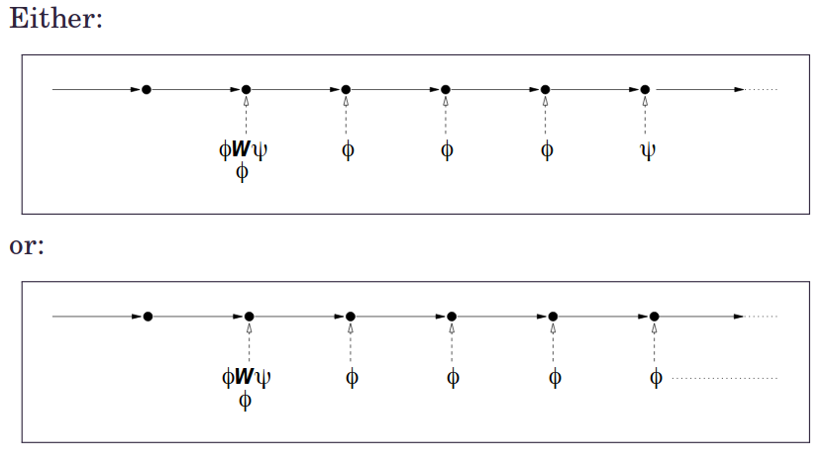
TEMPORAL OPERATOR: UNLESS
Notes:
34

Slide 35
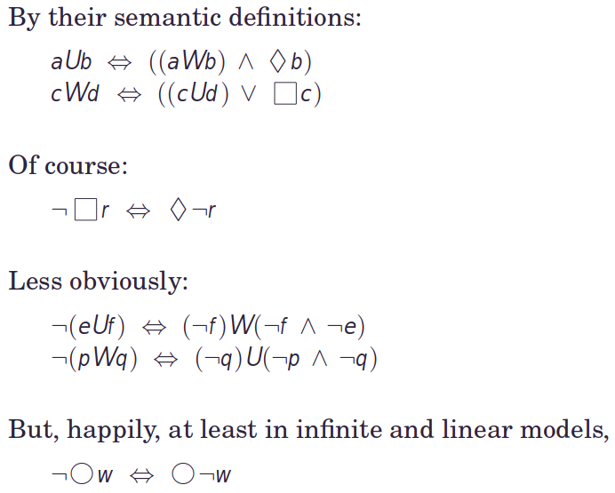
USEFUL INTERACTIONS
Notes:
35

Slide 36

THANK YOU
Notes:
36

